Slide 1
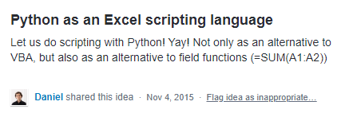
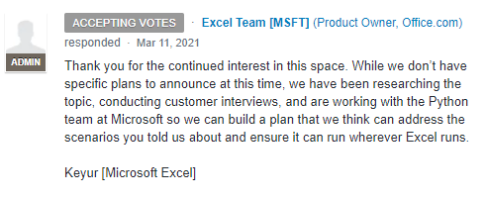
how it started how it’s going

Slide 2





Reject modernity
Embrace tradition

Slide 3
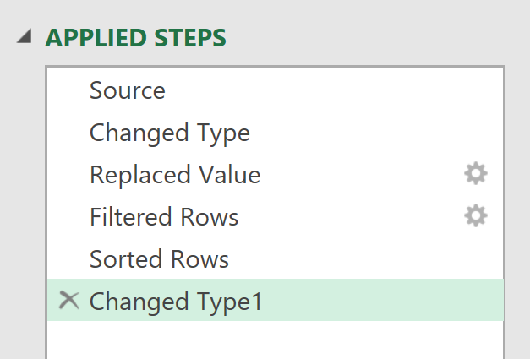
EVERY STEP YOU TAKE
I’LL BE WATCHING YOU

Slide 4

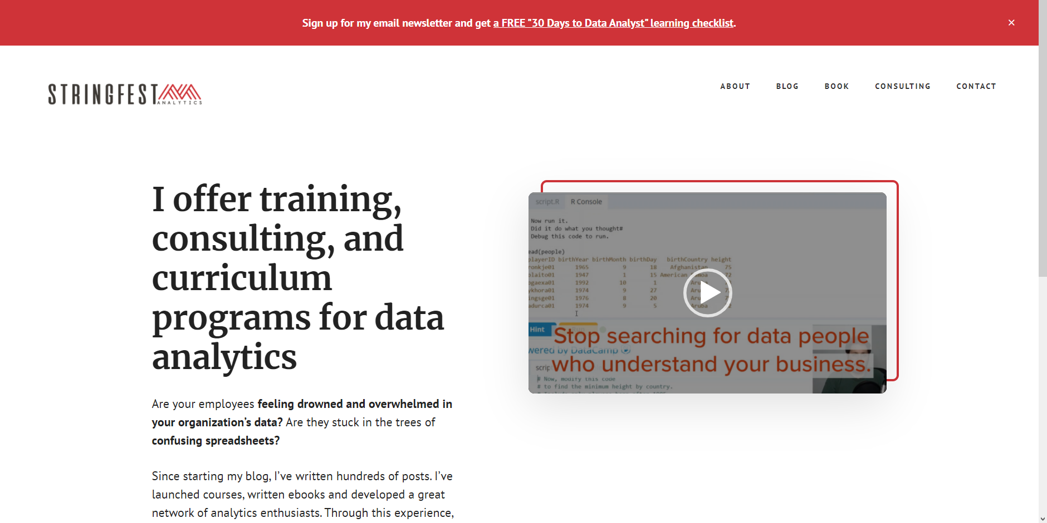
how it started
how it’s going

Slide 5

DATA ANALYSTS
R/PYTHON
R/PYTHON
R/PYTHON
ADVANCED ANALYTICS
REPRODUCIBLE PROJECTS
AUTOMATED TASKS
COMPELLING VISUALIZATIONS
HIGHER PAY

Slide 6


ANALYSTS
ACCOUNTANTS
MARKETERS
INVESTORS
TEACHERS
ENGINEERS
ECOLOGISTS
EVALUATORS
PHYSICIANS
ADMINISTRATORS

Slide 7


CLIPPY GETS HIS REVENGE

Slide 8

BI tool with limited statistical capabilities:
“Sure, we can do AI…”

Slide 9

When you search online to get help and your own post shows up

Slide 10

Working on a business project
Working on a business project with an upcoming deadline

Slide 11
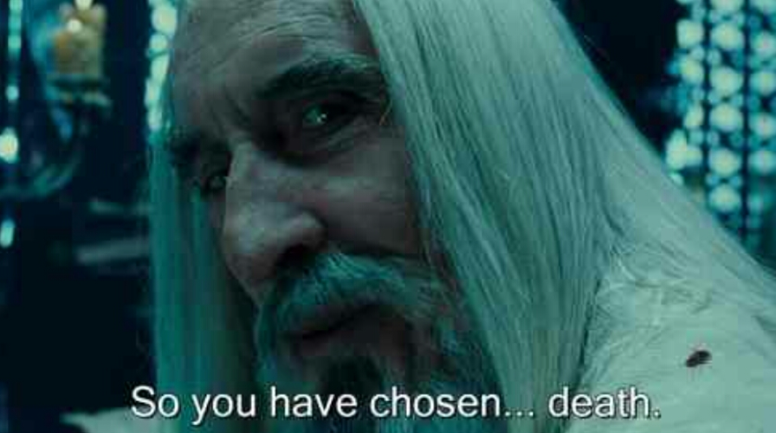
Technical debt

Slide 12

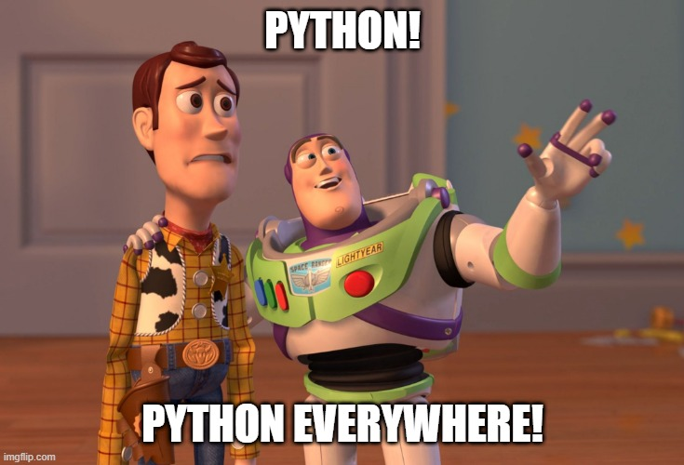




Slide 13

Salesman: *slaps roof*
“This dashboard can fit so much chartjunk in it”

Slide 14


*Slaps cover*
“This baby makes a great Christmas gift”

Slide 15

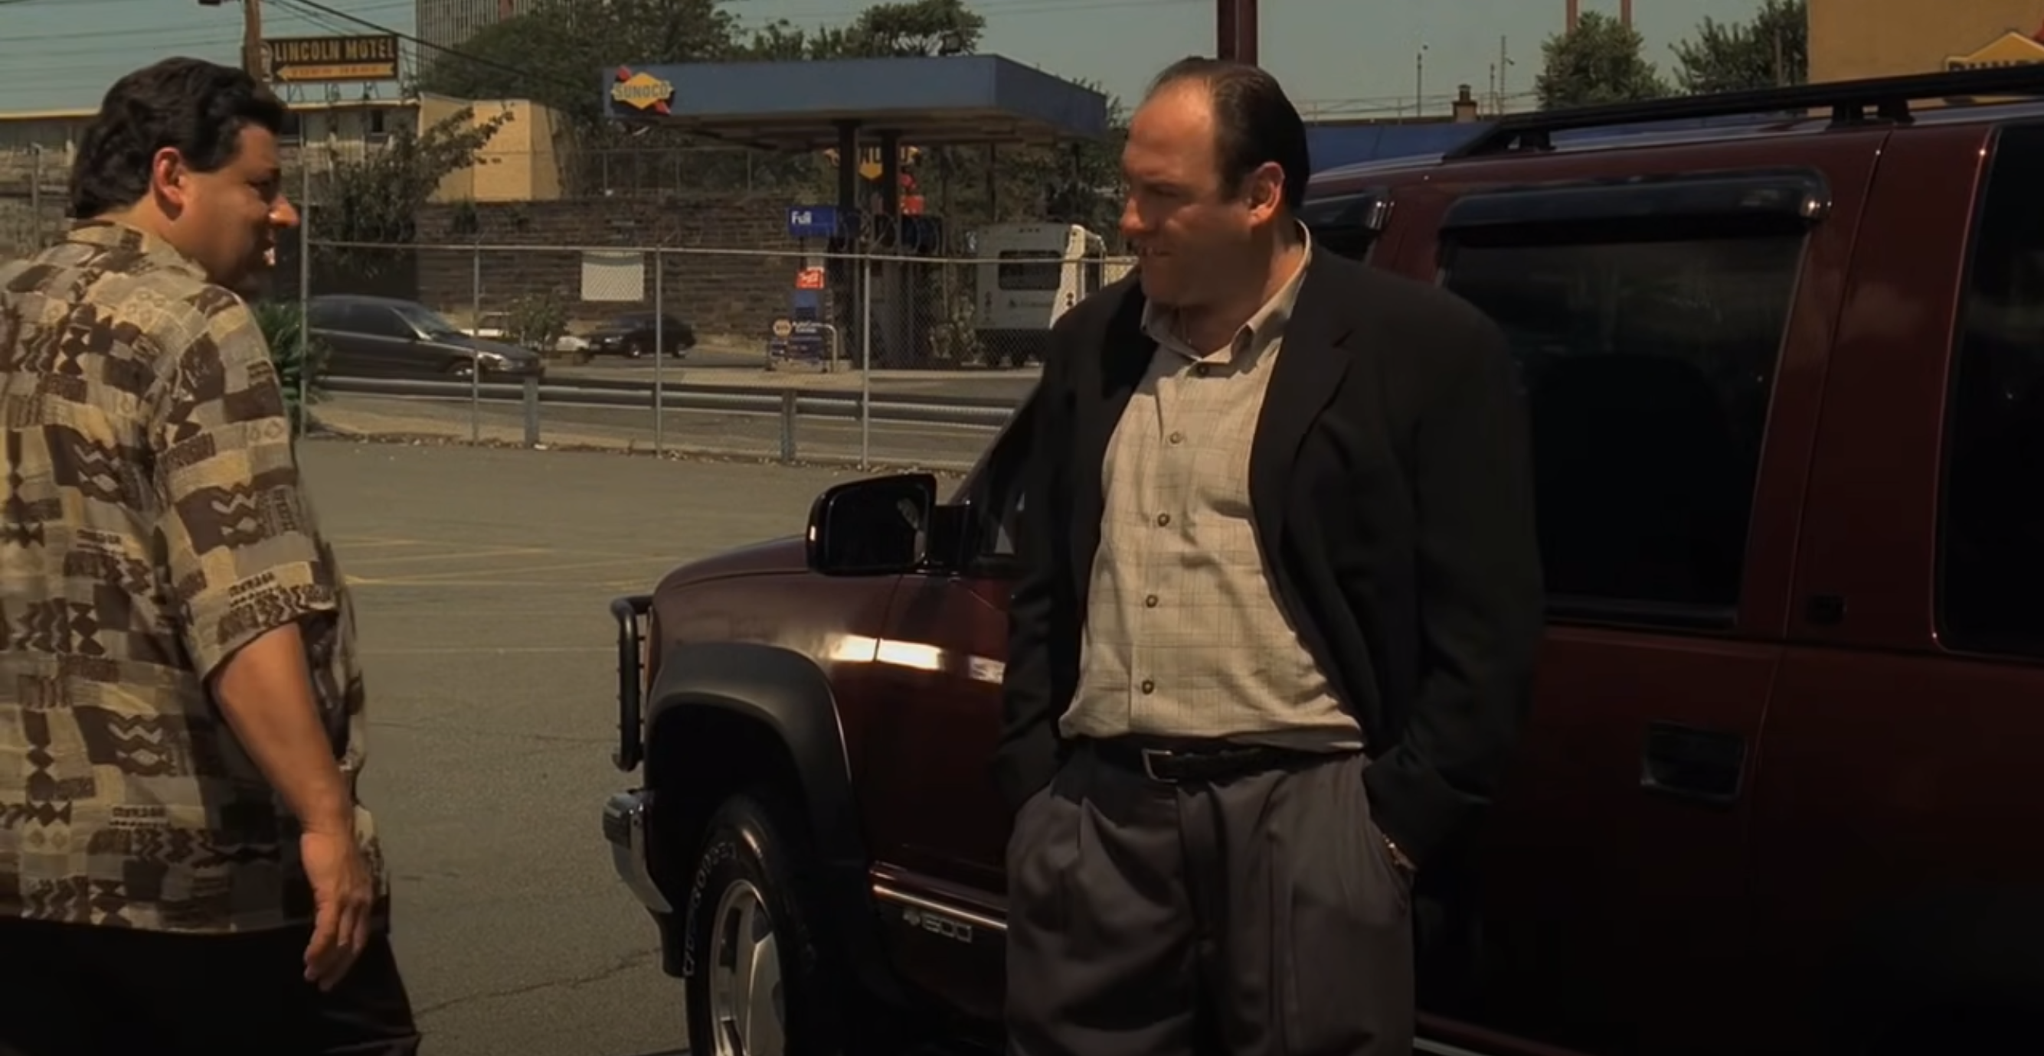
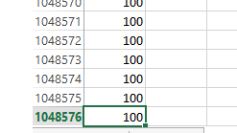

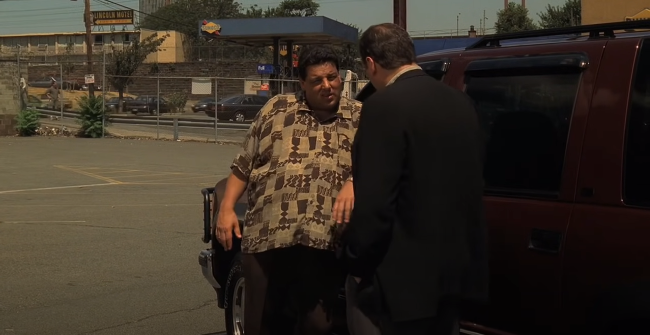
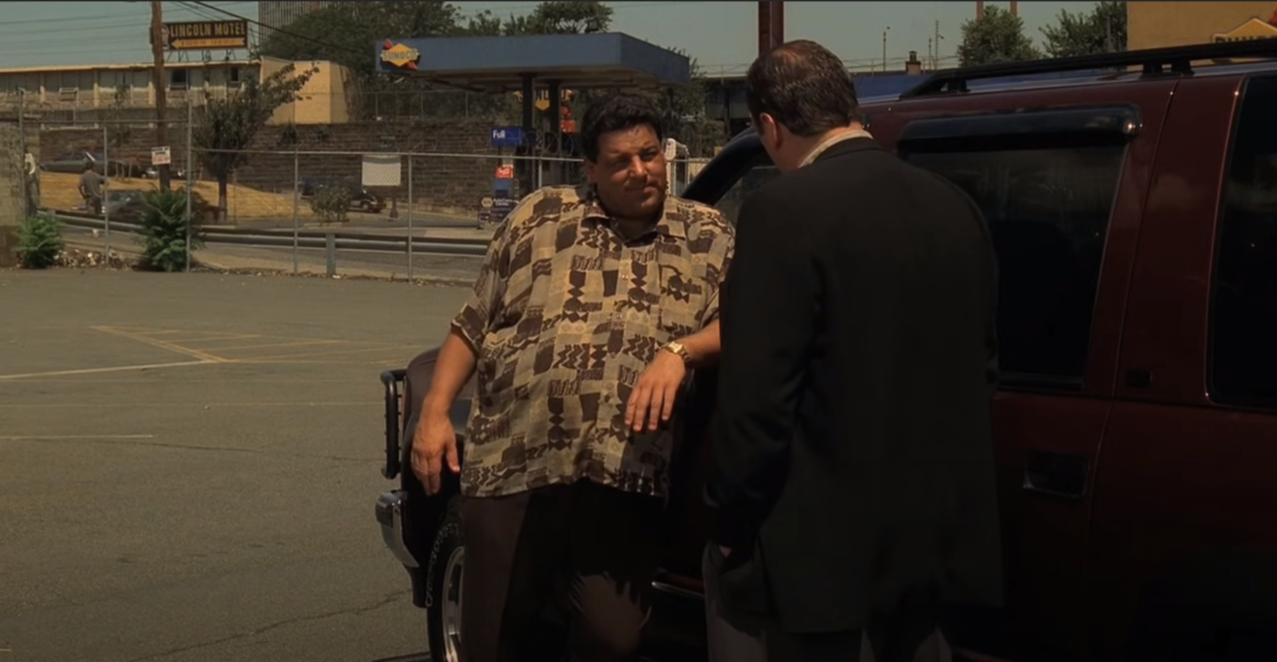

I think it's time for you to start to seriously consider Power Query.
What do you mean?
What do I mean? I mean convert that data into a table before you crash the file, you fat workbook.

Slide 16


Slide 17
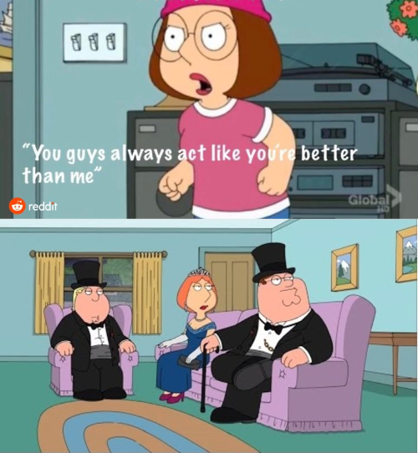




Slide 18
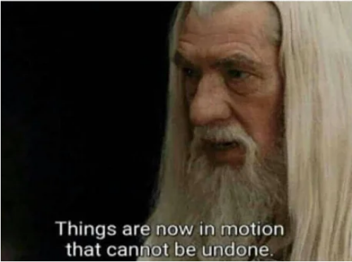
Deleting an applied step in Power Query:

Slide 19

“It’s not about the tools, it’s about asking the right questions”
Ought implies can. You can’t answer the questions without the tools

Slide 20

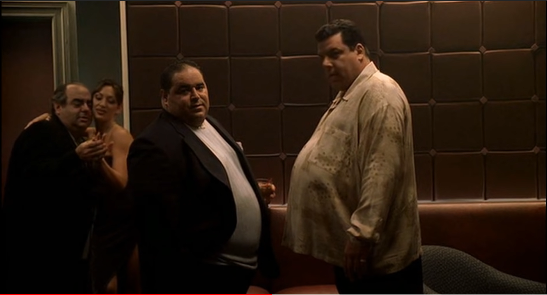
IT’S LIKE A TUTORIAL FOR FEATURE SELECTION…
BEFORE… AND WAYY BEFORE.

